Slide 1
Research in program synthesis
More in CS703 – Program verification and synthesis
Loris D’Antoni

Slide 2
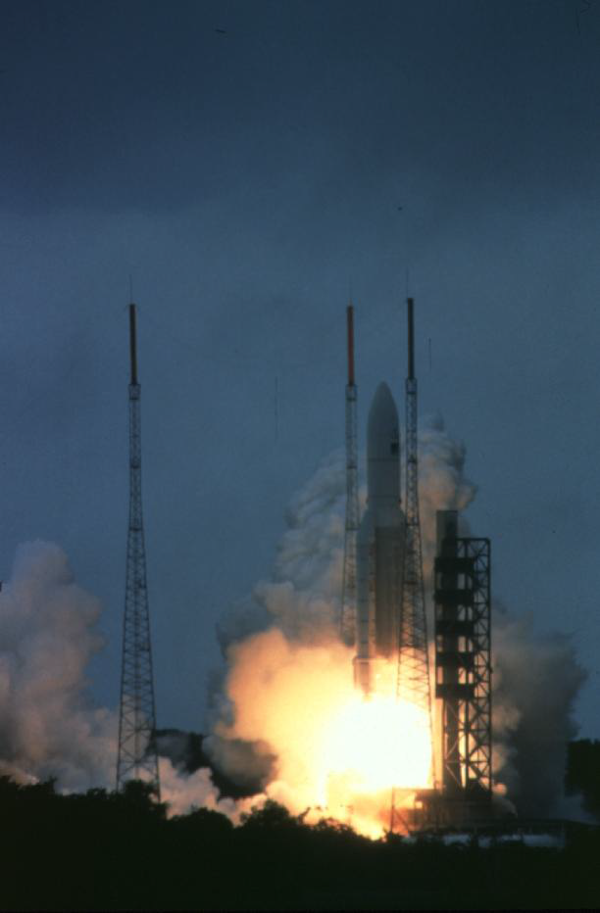
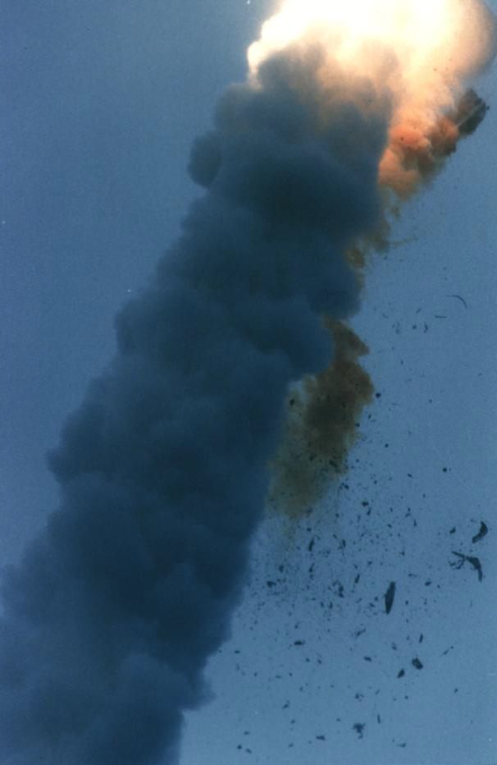
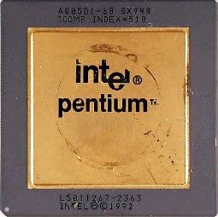
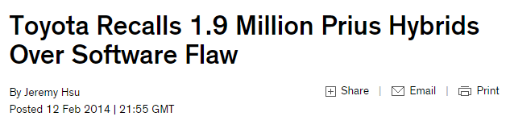
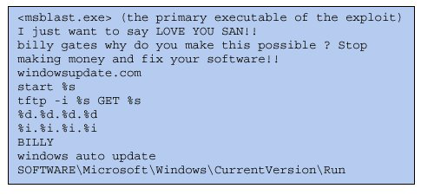
Ariane disaster, 1996
$500 million software failure
Bugs cost Time, Money, Lives, …
FDIV error, 1994
$500 million
Estimated worst-case worm cost:
> $50 billion
Credit: S. A. Seshia
Notes:
For many years researchers have been trying to
improve programmers productivity by answering this question.
How do we build reliable software?
Given some piece of code we would like some techniques that
Tell us whether our code does more or less what we intend it to do
The techniques developed towards this goal can be divided into 2 classes:
Those that target general programs and try to answer questions such as…
And techniques that target restricted domains such as…
In this domains one can try to build simpler but complete abstractions to perform powerful analysis

Slide 3
Solutions
Program verification
Does my program do what it is supposed to do?
Program
synthesis
Can you generate a program that does what I have in mind and does not contain bugs?

Slide 4
Program verification
In 4 slides

Slide 5
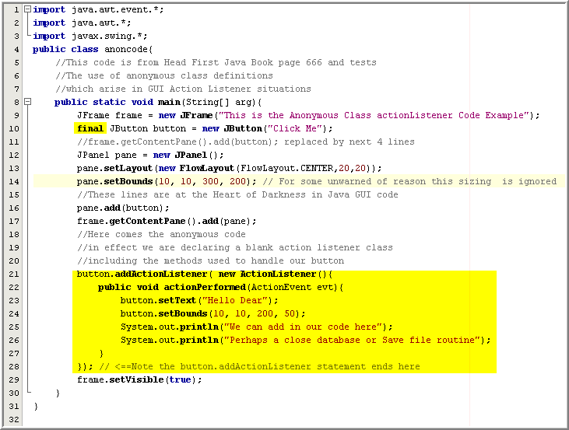

What is program verification?
Input
Output
Program
YES Proof
UNDECIDABLE
Verifier
Property
No null pointer exception is ever triggered
NO Counterexample

Slide 6
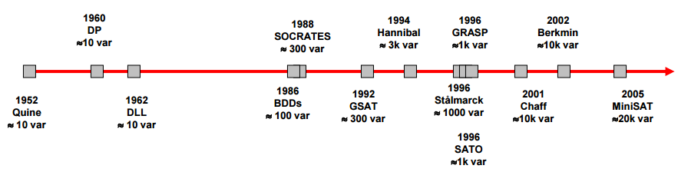
How bad is it?
Even the “easiest” verification problem is NP-Complete (SAT)

Slide 7
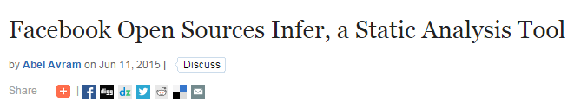
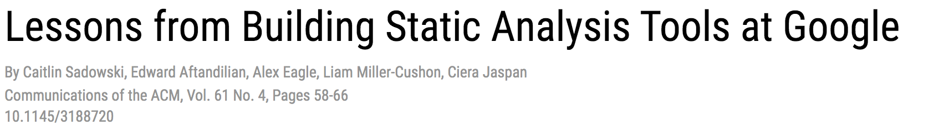
Never give up

Slide 8
Reasons behind success
Wonderful theory
Domain-specific knowledge
Engineering efforts
Automata theory
Model checking
Abstraction
Programming device drivers
Malware fingerprinting
API usage in Android
Router filtering
Security protocols
String encoding
SAT solvers SMT solvers
…
We will learn a bit about each of these topics in this class!

Slide 9
Program synthesis

Slide 10
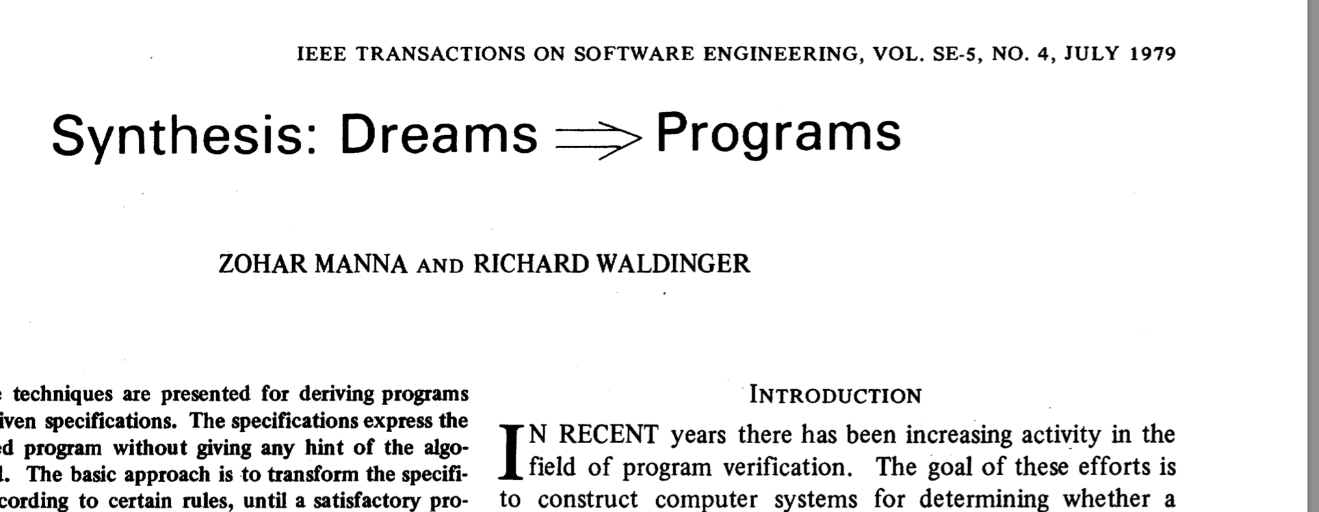
What is program synthesis?

Slide 11

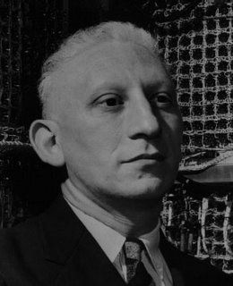
What is software synthesis
When someone says "I want a programming language in which I need only say what I wish done," give him a lollipop.
-Allan Perlis 1982
Notes:
The hubris is best captured by this quote from Allan Perlis from the early eighties.
Since then, and in particular in the last 8 years, the technology for synthesis has advanced a lot, but one could argue that Perlis quote is still current. Beyond a certain level of complexity, it is unreasonable to expect a synthesizer to derive from scratch algorithms that have taken years to develop by the best minds in our field.
In addition to the harness question, there was a second critique to the Dreams=>Programs agenda: dreams don’t make very good specs.

Slide 12
What is program synthesis?
EVEN MORE
UNDECIDABLE
Input
Output
User intent
Program
1 -> 0
340 -> 300
568 -> 500
Function f(x){
If(length(x)<3)
return 0
Else
return x[0]+`00’
}
Synthesizer
Domain knowledge
Program can only use:
Length(x), if(x)then y else z, x[i],…

Slide 13
Never give up
Automatic program repair
Parsers from examples
Network updates from specification
Biological models from mutations
Automatic feedback for programming assignments [Singh+14]
Reactive controllers
FlashFill video [Gulwani11]

Slide 14
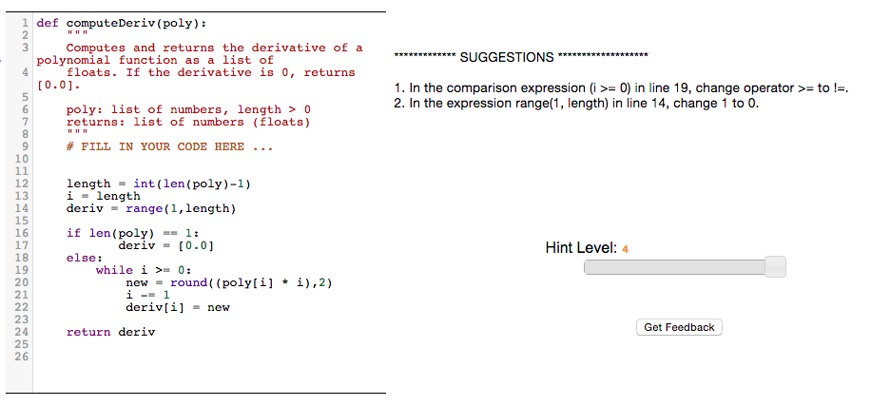

Slide 15
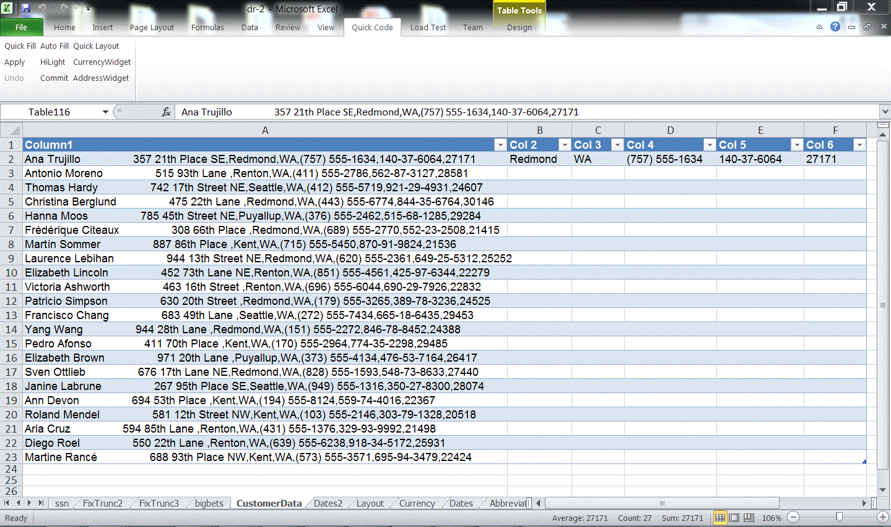
FlashFill: a feature of Excel 2013 (Sumit Gulwani et al.)
Notes:
One recent exciting example of domain specific synthesis was developed by Gulwani for automatically producing Excel macros from examples. In this slide we see that column A contains a line of text with personal data. Columns B, C, D, E, and F contain extracted elements of the data in column A, as shown in the first row. Using the first row, Gulwani’s system will synthesize a program that, given data in column A, will produce the data on columns B to E. As shown in the next slide, this program can then be applied to the remaining rows to produce the desired result.

Slide 16
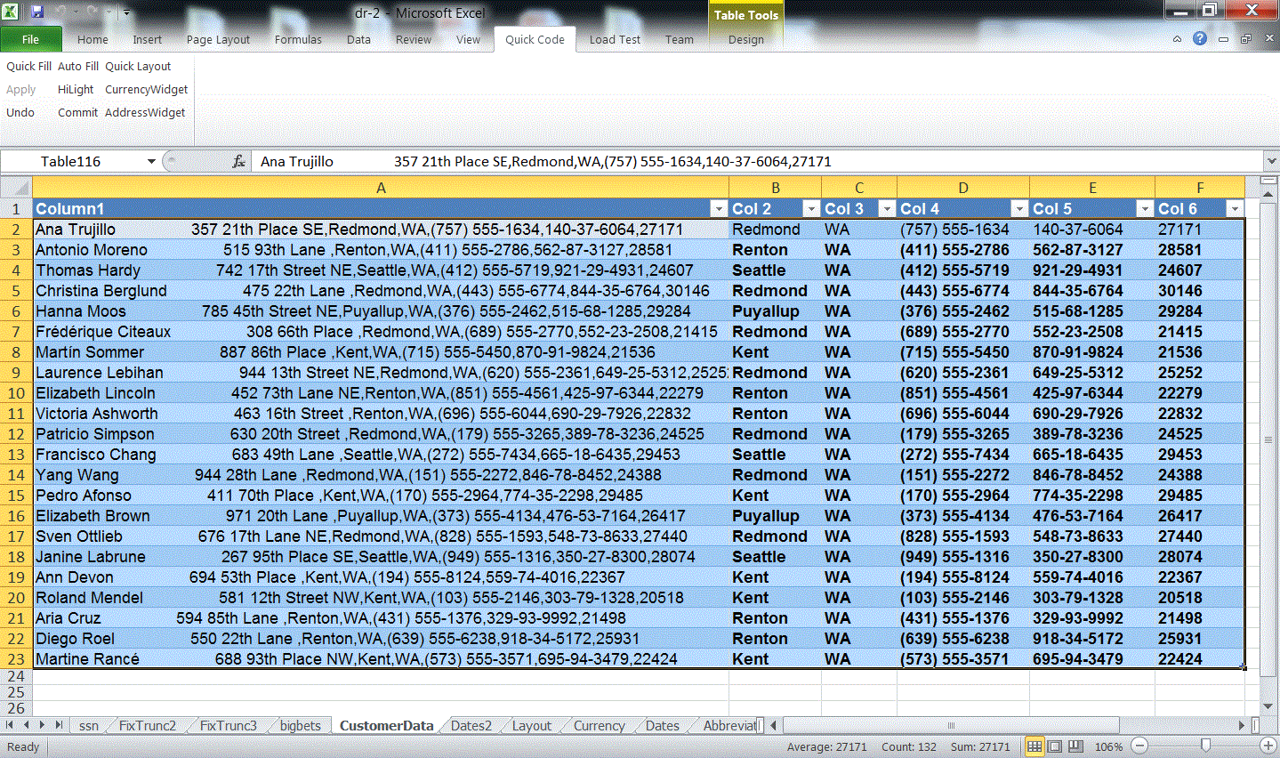
FlashFill: a feature of Excel 2013 (Sumit Gulwani et al.)
Notes:
Result of the program generated from the first row applied to the remaining rows.

Slide 17
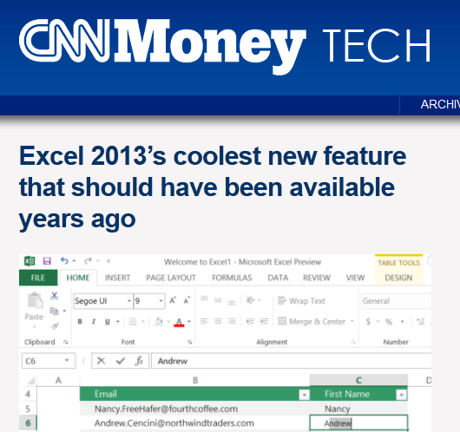
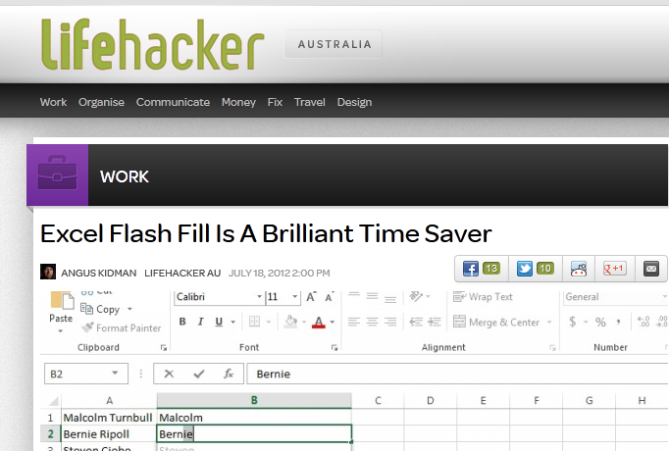

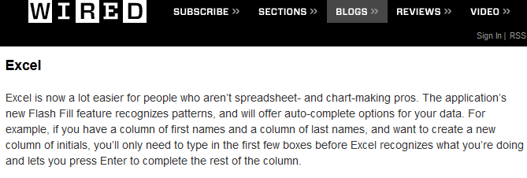





Real world application of synthesis

Slide 18
For every synthesis problem…
How do you tell the system what you want?
What is the specification formalism
What is the interaction model
What happens when there is ambiguity
How do you represent domain knowledge?
How do you guide the system towards relevant programs
How can you take advantage of the structure of the space of programs you care about
How does the system find the program you actually want?
And how does it know it is the program you want
Notes:
As we talk about these different forms of synthesis, we are going to be

Slide 19
Different types of synthesis
Inductive Synthesis
Functional Synthesis
Reactive Synthesis
Quantitative Synthesis

Slide 20
Inductive Synthesis
Synthesize a program whose behavior satisfies a set of examples
Traditional Machine Learning
Inductive Synthesis
Learn a function from a set of examples
Scalability is very important, algorithms must scale to millions of data points
Data is assumed to be noisy;
need to avoid overfitting
Space of possible functions is highly stylized
Background knowledge incorporated as preprocessing and feature selection
Learn a function from a set of examples
Scalability is not so important, usually we are dealing with small numbers of examples
Data is assumed to be clean
It’s annoying when user says f(x)=y and the system assumes the user is wrong and decides that f(x)=z
Space of possible functions can be arbitrary
Background knowledge encoded in the description of the space and in the search itself

Slide 21


Programming by Example: Motivation
Two major criticisms of synthesis:
It’s too hard to make it work
Even if it works, it ends up being too hard to use
Algorithm
Designers
(logics, automata, etc.)
Software Developers
Most Useful Target
End-Users
Students and Teachers
(Examples!)
Notes:
Recall last time we talked about two major criticisms of synthesis:
It’s too hard to make it work.
Even if it works, it ends up being too hard to use.
The dream of PBE was to address the second criticism by allowing users to simply give examples of the behaviors they want and have the system generalize from these examples.

Slide 22
FlashFill: a feature of Excel 2013 (Sumit Gulwani et al.)
Notes:
One recent exciting example of domain specific synthesis was developed by Gulwani for automatically producing Excel macros from examples. In this slide we see that column A contains a line of text with personal data. Columns B, C, D, E, and F contain extracted elements of the data in column A, as shown in the first row. Using the first row, Gulwani’s system will synthesize a program that, given data in column A, will produce the data on columns B to E. As shown in the next slide, this program can then be applied to the remaining rows to produce the desired result.

Slide 23
Example:Least Significant Zero Bit
0010 0101 → 0000 0010
Trick:
Adding 1 to a string of ones turns the next zero to a 1
i.e. 000111 + 1 = 001000
int W = 32;
bit[W] isolate0 (bit[W] x) { // W: word size
bit[W] ret = 0;
for (int i = 0; i < W; i++)
if (!x[i]) { ret[i] = 1; return ret; }
}

Slide 24
Space of possible implementations
/**
* Generate the set of all bit-vector expressions
* involving +, &, xor and bitwise negation (~).
* the bnd param limits the size of the generated expression.
*/
generator bit[W] gen(bit[W] x, int bnd){
assert bnd > 0;
if(??) return x;
if(??) return ??;
if(??) return ~gen(x, bnd-1);
if(??){
return {| gen(x, bnd-1) (+ | & | ^) gen(x, bnd-1) |};
}
}

Slide 25
Example: Least Significant Zero Bit
generator bit[W] gen(bit[W] x, int bnd){
assert bnd > 0;
if(??) return x;
if(??) return ??;
if(??) return ~gen(x, bnd-1);
if(??){
return {| gen(x, bnd-1) (+ | & | ^) gen(x, bnd-1) |};
}
}
bit[W] isolate0sk (bit[W] x) implements isolate0 {
return gen(x, 3);
}

Slide 26
Program synthesis with guarantees
Does it work?

Slide 27
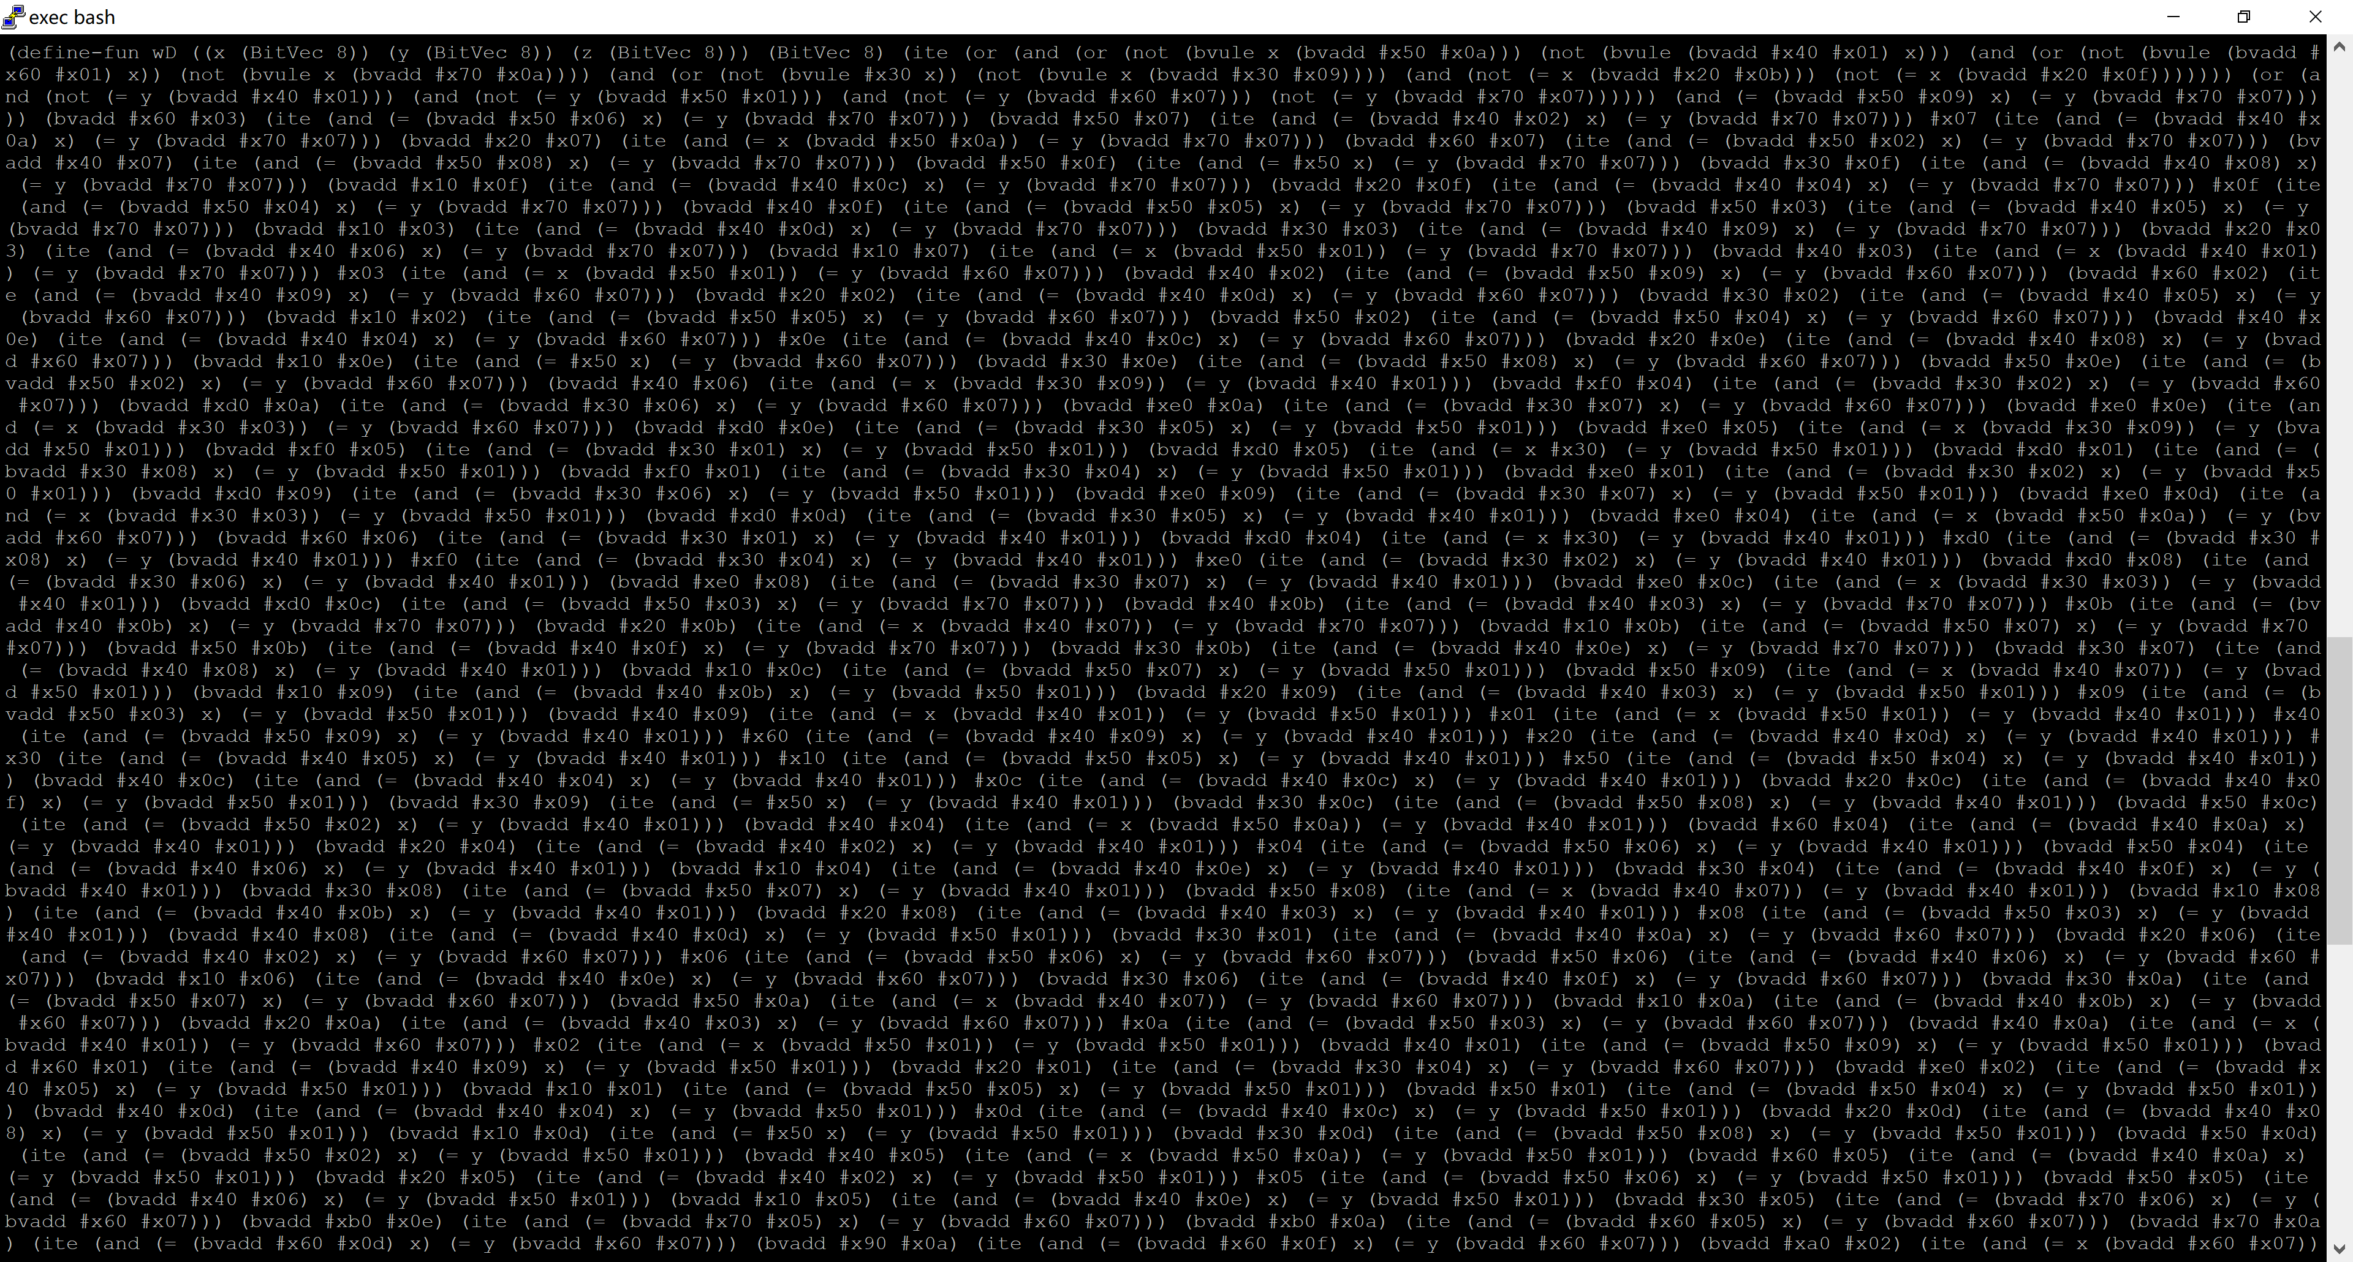
Program synthesis is
Search space
Need a way to specify which solutions are better and synthesize the best solution
Solution space

Slide 28
“Synthesis is like a box of chocolate,
You never know what you’re gonna get”

Slide 29
Program synthesis with guarantees
Specification
Synthesizer
Program
Proof that no program meets the specification
Search space
Ability to prefer a solution when there are multiple ones
Program that satisfies a probabilistic version of the specification

Slide 30
Program synthesis with guarantees
Specification
Synthesizer
Program
Proof that no program meets the specification
Search space
Ability to prefer a solution when there are multiple ones
Program that satisfies a probabilistic version of the specification

Slide 31
Syntax-guided synthesis with quantitative objectives
Q. Hu, L. D'Antoni [CAV18]

Slide 32
Notes:
In one of our previous work, when we were synthesizing the inversion f a given function
We expect the synthezier

Slide 33
Program synthesis with guarantees
Specification
Synthesizer
Program
Search space
Ability to prefer a solution when there are multiple ones
Size, Likelihood, Number of if-statements

Slide 34
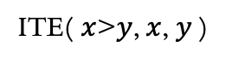
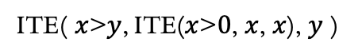
Syntax Guided Synthesis [Alur et al. 13]
Specification
SyGuS
Synthesizer
Program
ITE( $x$>$y$, $x$, $y$)
ITE( $x$>$y$, ITE($x$>$0$, $x$, $x$), $y$ )
Search space
Start := Start+Start
| ITE(BExpr,Start,Start)
| x | y | 0 | 1
BExpr := NOT(BExpr)
| Start > Start
| Start AND Start

Slide 35
Syntax Guided Synthesis [Alur et al. 13]
Formula
SyGuS
Synthesizer
Program
Context-free grammar

Slide 36
How to synthesizers work?
A bit beyond the scope of this lecture but
Idea 1: Enumerate all terms in the grammar until you find one that is correct
Idea 2: Randomly explore the search space using MCMC or similar techniques
Idea 3: Describe the problem (or a subset of it) as a constraint solving problem and search using a constraint solver
Idea 4: use machine learning to guess correct programs (we still don’t know how to do this well)

Slide 37
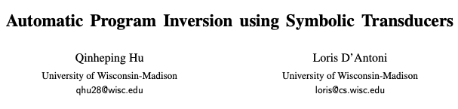
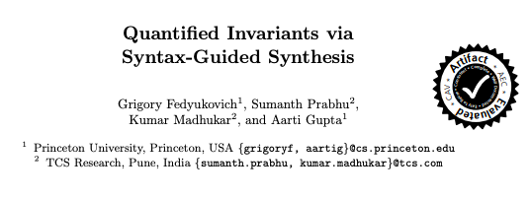
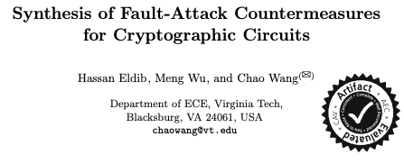
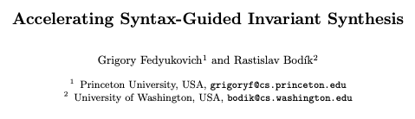
Applications of SyGuS

Slide 38
Adding quantitative objectives
Specification
SyGuS
Synthesizer
Program
ITE( $x$>$y$, $x$, $y$)
ITE( $x$>$y$, ITE($x$>$0$, $x$, $x$), $y$ )
Search space
Start := Start+Start
| ITE(BExpr,Start,Start)
| x | y | 0 | 1
BExpr := NOT(BExpr)
| Start > Start
| Start AND Start
Need a way to prefer the first solution

Slide 39
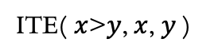
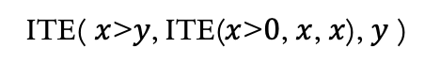
Adding quantitative objectives
Specification
SyGuS
Synthesizer
Program
ITE( $x$>$y$, $x$, $y$)
ITE( $x$>$y$, ITE($x$>$0$, $x$, $x$), $y$ )
Search space
Start := Start+Start
| ITE(BExpr,Start,Start) 1
| x | y | 0 | 1
BExpr := NOT(BExpr)
| Start > Start
| Start AND Start
Need a way to prefer the first solution

Slide 40
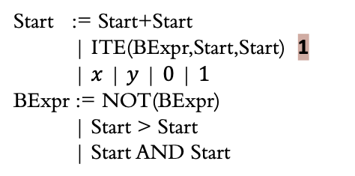
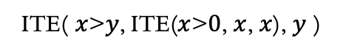
What is the weight of a program
ITE( $x$>$y$, ITE($x$>$0$, $x$, $x$), $y$ )
weight=2
Start := Start+Start
| ITE(BExpr,Start,Start) 1
| $x$ | $y$ | $0$ | $1$
BExpr := NOT(BExpr)
| Start > Start
| Start AND Start
ITE 1
> 0
ITE 1
y 0
x 0
y 0
> 0
x 0
x 0
x 0
0 0
Notes:
For example, in this program , this is a possible de tree,
The weight of this program is equal to the weight of its devation tree

Slide 41
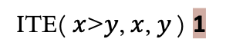
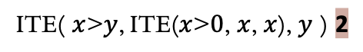
Adding quantitative objectives
Specification
SyGuS
Synthesizer
Program
ITE( $x$>$y$, $x$, $y$) 1
ITE( $x$>$y$, ITE($x$>$0$, $x$, $x$), $y$ ) 2
Search space
Start := Start+Start
| ITE(BExpr,Start,Start) 1
| x | y | 0 | 1
BExpr := NOT(BExpr)
| Start > Start
| Start AND Start
Programs now have weights/costs

Slide 42
Syntax Guided Synthesis with Quantitative Objectives
Formula
QSyGuS
Synthesizer
Program
Weighted grammar
How do we solve a QSyGuS problem?
Quantitative objective

Slide 43
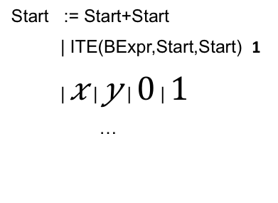
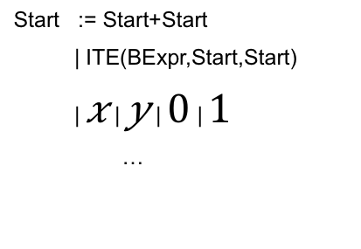
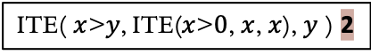
Solving QSyGuS problems
QSyGuS
SyGuS
SyGuS
Specification Weighted grammar
Specification Grammar
Specification Grammar
Ignore weights
Restrict grammar
Start := Start+Start
| ITE(BExpr,Start,Start) 1
| $x$ | $y$ | $0$ | $1$
…
Start := Start+Start
| ITE(BExpr,Start,Start)
| $x$ | $y$ | $0$ | $1$
…
ITE( $x$>$y$, ITE($x$>$0$, $x$, $x$), $y$ ) 2

Slide 44
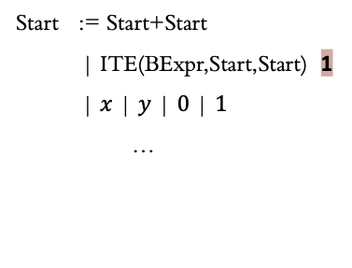
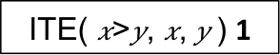
Solving QSyGuS problems
QSyGuS
SyGuS
SyGuS
Specification Weighted grammar
Specification Grammar
Specification Grammar
Ignore weights
Restrict grammar
Restrict grammar
Start := Start+Start
| ITE(BExpr,Start,Start) 1
| $x$ | $y$ | $0$ | $1$
…
Start := Start0 | Start1
Start0 := Start0+Start0
| x | y | 0 | 1
Start1 := ITE(BExpr, Start0, Start0)
| Start0+Start1 | Start1+Start0
| x | y | 0 | 1 …
ITE( $x$>$y$, ITE($x$>$0$, $x$, $x$), $y$ ) 2
ITE( $x$>$y$, $x$, $y$) 1

Slide 45
Soundness of grammar restriction
Weighted grammar does not contain negative weights
Reduced grammar accepts all and only the terms of weight < c
Results also generalizes to multiplicative weights

Slide 46
Program synthesis with guarantees
Specification
Synthesizer
Program
Proof that no program meets the specification
Search space
Ability to prefer a solution when there are multiple ones
Program that satisfies a probabilistic version of the specification

